Slide 1

User data report
By: Chelsea Evanich

Slide 2
What is the User Data?
The User Data consists of 11 columns and 552,339 rows about Yelp Users
The column names are:
User ID
Name
Review Count
Average Stars
Number of:
Cool Votes
Funny Votes
Useful Votes
Friends
Elite
Yelping Since
Number of Fans
Data Types
User Id, Name, Friends, Elite, and Yelping Since are objects
Review Count, Cool Votes, Funny Votes, Useful Votes, and Fans are integers
Average Stars are floats
Statistical Summary
Review Count: Range: 0 – 10,320 Median: 6
Average Stars: Range: 0 - 5 Median: 3.9
Cool Votes: Range: 0 – 52441 Median: 1
Funny Votes: Range: 0 – 45738 Median: 1
Useful Votes: Range: 0 – 55937 Median: 4

Slide 3
Relationships in the User Data?
The votes (cool, funny, useful) are all very correlated with each other with Pearson R Correlation scores consisting of:
Cool Votes and Funny Votes: 0.976
Cool Votes and Useful Votes: 0.983
Funny Votes and Useful Votes: 0.955
The closer the score is to 1 the strongest the positive linear relationship is, so these three relationships are very strong
Therefore, all the votes are highly correlated with each other, as one increases the other two columns tend to also increase

Slide 4
What can a Yelp user do to enhance their popularity and impact?
To define popularity on the platform Yelp, I referred to the number of fans a user has
To define impact, I referred to the number of useful votes a user has

Slide 5
How to increase fans on Yelp
By looking at a correlation matrix (a table that shows all correlation scores for all numeric data in data frame), I found that Cool, Funny, and Useful votes all have a strong positive correlation score with fans.
As mentioned previously, the closer a correlation score is to 1, the stronger the correlation is.
All three of these columns had correlation score of above 0.731, with useful votes being the highest at 0.789.
Which means the trend is that as you increase the number of funny, cool, and especially useful votes, the number of fans also increases.

Slide 6
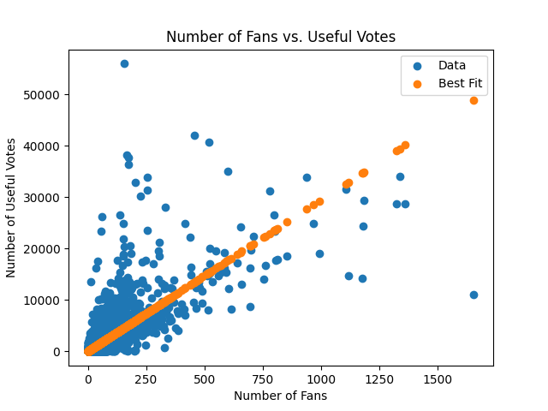
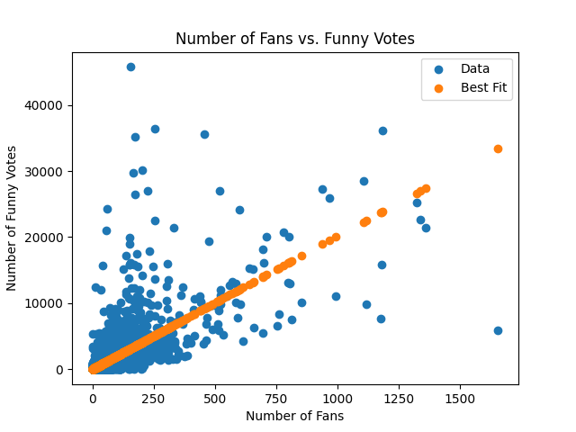
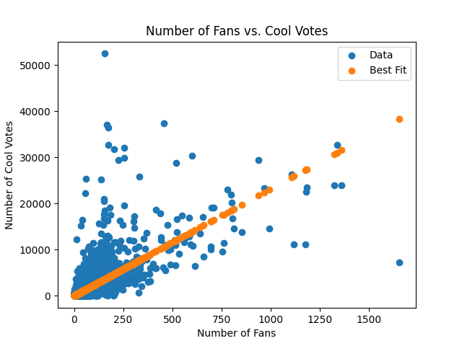
Notes:
these three scatter plots give a visual to the positive correlation scores

Slide 7
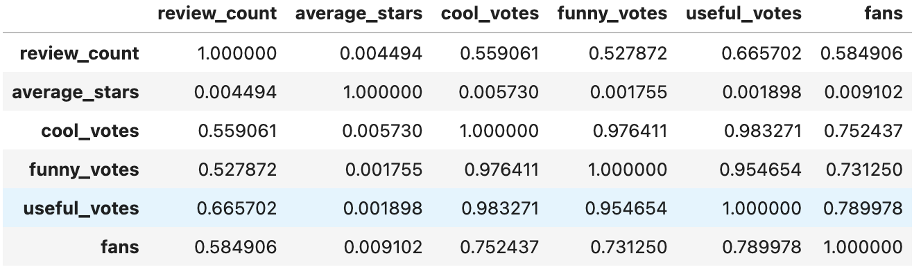
How to have a greater impact on Yelp?
I defined impact as useful votes, because if your votes are useful to others, then you are having an impact on the platform.
I used the correlation matrix to see what other columns were heavily correlated with useful votes.

Slide 8
Conclusion
This data shows to increase your fans on Yelp (popularity), it is best to try to get more cool, funny, and useful votes. Especially useful votes because it has the highest correlation with fans at 0.789
To increase your useful votes (impact), it is best to get more funny and cool votes, as their correlation scores with useful votes are both above 0.955.

